Slide 1

Management Information Systems: Managing the Digital Firm
Seventeenth Edition, Global Edition
Chapter 15
Managing Global Systems
Copyright © 2022, 2020, 2018 Pearson Education, Ltd. All Rights Reserved
Notes:
If this PowerPoint presentation contains mathematical equations, you may need to check that your computer has the following installed:
1) MathType Plugin
2) Math Player (free versions available)
3) NVDA Reader (free versions available)

Slide 2
Learning Objectives
15.1 What major factors are driving the internationalization of business?
15.2 What are the alternative strategies for developing global businesses?
15.3 What are the challenges posed by global information systems and management solutions for these challenges?
15.4 What are the issues and technical alternatives to be considered when developing international information systems?
15.5 How will M I S help my career?
Notes:
This chapter discusses the use and influence of information technology in developing a global business strategy. You could ask students to give an example of a global company and describe what it is that makes that company global. What are the advantages that a global firm has over an equivalent national firm?

Slide 3
Video Cases
Case 1: Daum Runs Oracle Apps on Linux.
Case 2: Lean Manufacturing and Global E R P: Humanetics and Global Shop

Slide 4
The Bel Group: Laughing All the Way to Success (1 of 2)
Problem
  Potential expansion
  Untouched market potential globally
Solutions
  Design global strategy and business model
  Redesign business processes
  Deploy Salesforce’s Sales Cloud software

Slide 5
The Bel Group: Laughing All the Way to Success (2 of 2)
Global CRM System
Demonstrates I T’s role in helping organizations pursue a global growth strategy
Illustrates the ability of I T systems to standardize global processes and rules

Slide 6
What Major Factors Are Driving the Internationalization of Business?
Global economic system and global world order driven by advanced networks and information systems
The growth of international trade has radically altered domestic economies around the globe
For example, production of many high-end electronic products parceled out to multiple countries
  For example: Apple iPhone’s global supply chain
Notes:
This slide emphasizes the role of advanced networks and information systems in enabling the growth of global economic systems and global world order. Ask students why networks and IT advances make globalization more feasible. The text uses the example of the path to market for an Apple iPhone to illustrate what globalization means for an international firm, illustrated in the next slide.

Slide 7
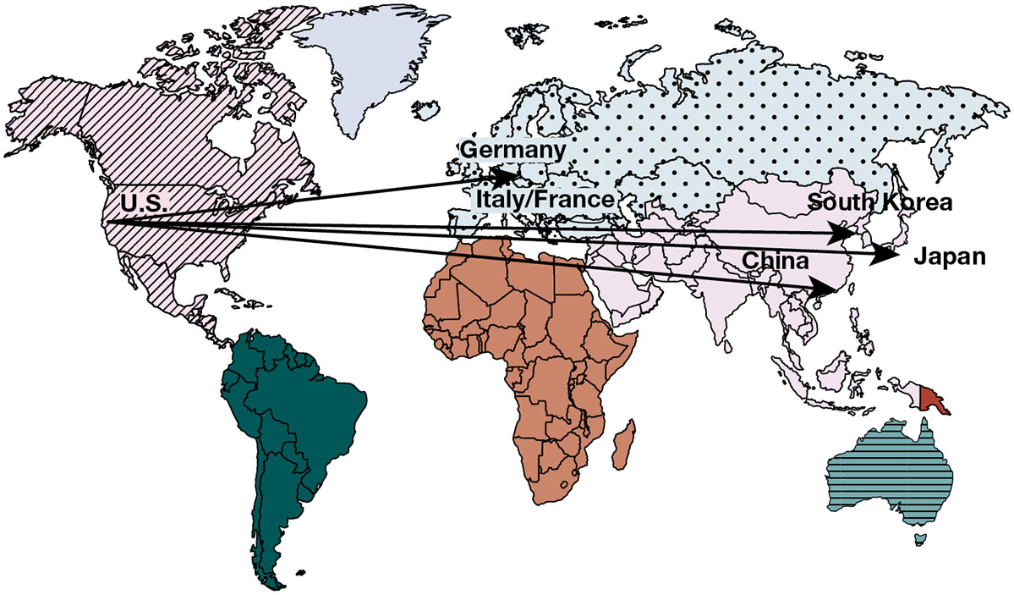
Figure 15.1: Apple iPhone’s Global Supply Chain
Notes:
Figure 15.1, Page 561.
Apple designs the iPhone in the United States and relies on suppliers in the United States, Germany, Italy, France, Japan, and South Korea for other parts. Much of the final assembly occurs in China.

Slide 8
Developing an International Information Systems Architecture
Understand global environment
  Business drivers for global competition
  Inhibitors creating management challenges
Develop corporate strategy for global competition
Develop organizational structure and division of labor
Consider management issues
  Design of business procedures, reengineering, managing change
Consider technology platform
Notes:
This slide discusses the strategy a firm should take in order to make a successful move toward globalization. Why would understanding the business drivers be the top consideration? Why is considering the technology platform the last consideration?

Slide 9
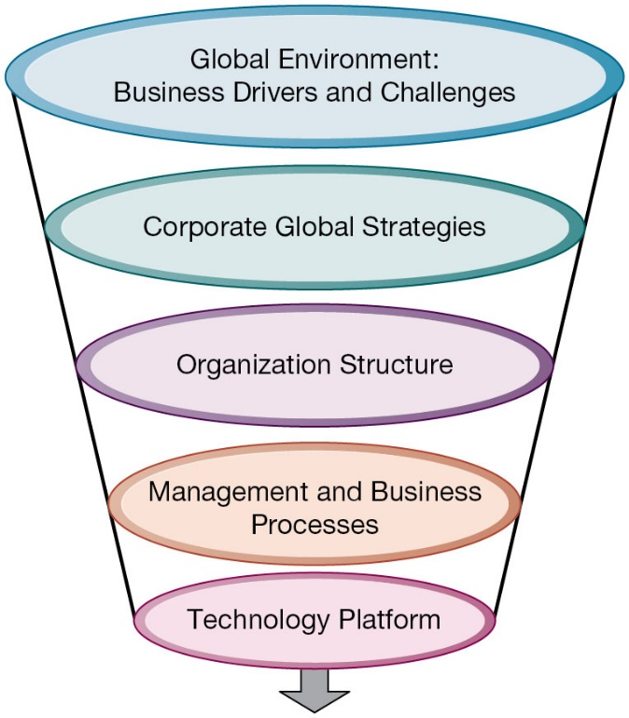
Figure 15.2 International Information Systems Architecture
Notes:
Figure 15.2, Page 562.
The major dimensions for developing an international information systems architecture are the global environment, the corporate global strategies, the structure of the organization, the management and business processes, and the technology platform.
This graphic illustrates the strategy for developing an international system. There are a variety of choices when determining a corporate global strategy. For example, you could sell to the globe from a domestic base or organize production and distribution around the world. Determining a global strategy means deciding what portions of the business are located globally. What would be the biggest factors in making this decision?
Alt Text
Long description: A funnel diagram explains the architecture of international information systems. The details from top to bottom are as below:
Global Environment: Business drivers and challenges
Corporate global strategies
Organization structure
Management and business processes
Technology platform.

Slide 10
The Global Environment: Business Drivers and Challenges
Business drivers
  General cultural factors
  Specific business factors
Challenges
  Global
  Specific
Notes:
The first strategic consideration in building an international system is to examine the global environment in terms of business drivers and challenges. This slide and the next two examine business drivers and challenges that lead industries toward global markets and competition.

Slide 11
Table 15.1: The Global Environment: Business Drivers and Challenges
General Cultural Factors | Specific Business Factors
Global communication and transportation technologies | Global markets
Development of global culture | Global production and operations
Emergence of global social norms | Global coordination
Political stability | Global workforce
Global knowledge base | Global economies of scale
Notes:
Table 5.1, Page 563.
Ask students what global culture is and how this influences internationalization. Ask students to explain what the global knowledge base is, and how this has changed over the past half-century. Can all industries benefit equally from globalization? Why or why not?

Slide 12
Table 15.2 Challenges and Obstacles to Global Business Systems
Global | Specific
Cultural particularism: Regionalism, nationalism, language differences | Standards: Different Electronic Data Interchange (E D I), e-mail, telecommunications standards
Social expectations: Brand-name expectations, work hours | Reliability: Phone networks not uniformly reliable
Political laws: Transborder data and privacy laws, commercial regulations | Speed: Different data transfer speeds, many slower than United States
Blank | Personnel: Shortages of skilled consultants
Notes:
Table 15.2, Page 566.
This slide continues the discussion of the challenges to internationalization and looks at specific challenges that firms face. Ask students to define particularism and to provide an example of it. How would particularism, regionalism, or nationalism affect the success of a busines trying to globalize. What is transborder data flow? With the use of the Internet, how is transborder data flow an issue. Another challenge discussed in the text is different accounting standards. How can accounting standards be different from country to country? Ask students how an accounting standard can pose difficulties to developing a global information system.

Slide 13
Interactive Session: Management: Rethinking Global Supply Chains
Class discussion
  What factors have contributed to the growth of global supply chains?
  What are the advantages and disadvantages of global supply chains?
  What measures can companies take to mitigate supply chain risk?
  Should companies continue to maintain global supply chains? Explain your answer.

Slide 14
State of the Art
Most companies have inherited a patchwork international system using traditional batch-oriented reporting, manual data entry, legacy systems, and little online control
Significant difficulties in building appropriate international architectures
  Planning a system appropriate to firm’s global strategy
  Structuring organization of systems and business units
  Solving implementation issues
  Choosing right technical platform
Notes:
This slide describes the reality of global information systems in use in typical businesses today. Few businesses that have begun to internationalize have top-of-the-line systems and face powerful competition from those companies that do have truly international systems.

Slide 15
Global Strategies and Business Organization
Three main kinds of organizational structure
  Centralized: In the home country
  Decentralized/dispersed: To local foreign units
  Coordinated: All units participate as equals
Four main global strategies
  Domestic exporter
  Multinational
  Franchisers
  Transnational
Notes:
This slide discusses the general ways business activities can be organized and the four main business strategies used by global companies. Ask students to describe each of the strategies (domestic exporter, multinational, franchiser, transnational) and to provide an example.

Slide 16
Table 15.3 Global Business Strategy and Structure
Business Function | Domestic Exporter | Multinational | Franchiser | Transnational
Production | Centralized | Dispersed | Coordinated | Coordinated
Finance/accounting | Centralized | Centralized | Centralized | Coordinated
Sales/marketing | Mixed | Dispersed | Coordinated | Coordinated
Human resources | Centralized | Centralized | Coordinated | Coordinated
Strategic management | Centralized | Centralized | Centralized | Coordinated
Notes:
Table 15.3, Page 568.

Slide 17
Global Systems to Fit the Strategy
Configuration, management, and development of systems tend to follow global strategy chosen
Four main types of systems configuration
  Centralized: Systems development and operation occur totally at domestic home base
  Duplicated: Development occurs at home base but operations are handed over to autonomous units in foreign locations
  Decentralized: Each foreign unit designs own solutions and systems
  Networked: Development and operations occur in coordinated fashion across all units

Slide 18
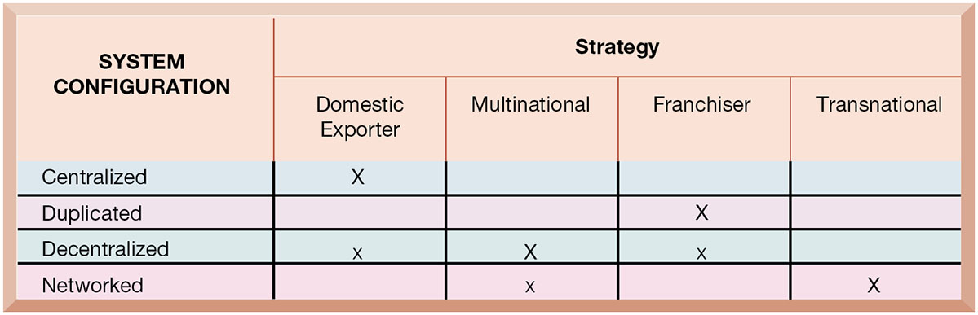
Figure 15.3 Global Strategy and Systems Configurations
Notes:
Figure 15.3, Page 570.
The large Xs show the dominant patterns, and the small Xs show the emerging patterns. For instance, domestic exporters rely predominantly on centralized systems, but there is continual pressure and some development of decentralized systems in local marketing regions.
This table shows which system configurations are typically used when a firm employs one of the four global strategies. The large Xs show the dominant patterns whereas the small Xs show the emerging pattern. The transnational has the most ambitious form of systems development, using a singular global environment. This structure is most visible in financial services companies, where the homogeneity of the product (money, money instruments) seems to overcome cultural barriers.
Alt Text
Long description: A table explains the strategies based on system configurations. The details corresponding to the system configuration and strategies are as below:
Centralized: Domestic exporter: Large X; Multinational: NA; Franchiser: NA; Transitional: NA.
Duplicated: Domestic exporter: NA; Multinational: NA; Franchiser: Large X; Transitional: NA.
Decentralized: Domestic exporter: Small X; Multinational: Large X; Franchiser: Small X; Transitional: NA.
Networked: Domestic exporter: NA Multinational: NA; Franchiser: NA; Transitional: Large X.

Slide 19
Reorganizing the Business
To develop a global company and information systems support structure:
  Organize value-adding activities along lines of comparative advantage-
    For example: Locate functions where they can best be performed, for least cost and maximum impact and reliability (with safeguards for supply chain resiliency)
  2. Develop and operate systems units at each level of corporate activity—regional, national, and international
  3. Establish at world headquarters:
    Single office responsible for development of international systems
    Global C I O position
Notes:
This slide discusses how a firm should organize itself for doing business on an international scale and offers three main principles to follow when developing a global company and information systems support structure. Ask students to explain the second principle. For local needs, there should be host country systems units; regional systems units should handle systems development across national boundaries but within major geographic regions; transnational systems should create linkages across and between regional systems. What types of systems would serve local over regional needs?

Slide 20
A Typical Scenario: Disorganization on a Global Scale
Traditional multinational consumer-goods company based in United States and operating in Europe would like to expand into Asia
World headquarters and strategic management in United States
Separate regional, national production and marketing centers
Foreign divisions have separate I T systems
E-mail systems are incompatible
Each production facility uses different E R P system, different hardware and database platforms, and so on
Notes:
This slide describes a common scenario of a multinational company and the challenges it faces in trying to develop a transnational information system as it expands into Asian markets. What types of implementation problems can the company expect when it begins development? Can resistance be expected even from the IT departments in different countries? The text describes some likely reactions (the foreign divisions will resist efforts to agree on common user requirements, U.S. systems groups will not easily accept guidance from anyone recommending a transnational strategy, etc.).

Slide 21
Global Systems Strategy (1 of 2)
Share only core systems
  Core systems support functionality critical to firm
Partially coordinate systems that share some key elements
  Do not have to be totally common across national boundaries
  Local variation desirable
Peripheral systems
Need to suit local requirements only
Notes:
This slide looks at the basic framework of a solution to implementing a transnational information system. Ask students what types of systems might be considered “core systems.” What types of systems might fall into the partially coordinated category? The peripheral systems category?

Slide 22
Global Systems Strategy (2 of 2)
Define core business processes
Identify core systems to coordinate centrally
Choose an approach
  Piecemeal and grand design approaches tend to fail
Make benefits clear
  Global flexibility
  Gains in efficiency (but more emphasis now on supply chain resiliency)
  Fixed costs amortized over a larger customer base; creates new economies of scale
  Ability to optimize corporate funds over much larger capital base
Notes:
This slide outlines the steps in creating a successful global systems solution appropriate to the firm’s goals and strategies. Ask students how a firm would determine its core business processes? (Conduct business process analysis.) Emphasize that the second step is to define the core systems identified as the transnational systems, and these should be kept to a minimum. Emphasize that it is crucial for senior managers at headquarters and in foreign divisions to understand the benefits. Ask students how a larger customer base unleashes economies of scale. What does optimizing corporate funds over a larger capital base mean?

Slide 23
The Management Solution: Implementation (1 of 2)
Agreeing on common user requirements
  Short list of core business processes
  Develop common language, understanding of common elements and unique local qualities
Introducing changes in business processes
  Success depends on legitimacy, authority, ability to involve users in change design process
Coordinating applications development
  Coordinate change through incremental steps
  Reduce set of transnational systems to bare minimum
Notes:
What is meant by “developing a common language to discuss the business” and why is this important? Ask students to define legitimacy. Emphasize that, at the global level, there is far too much complexity to implement full-scale, worldwide application changes.

Slide 24
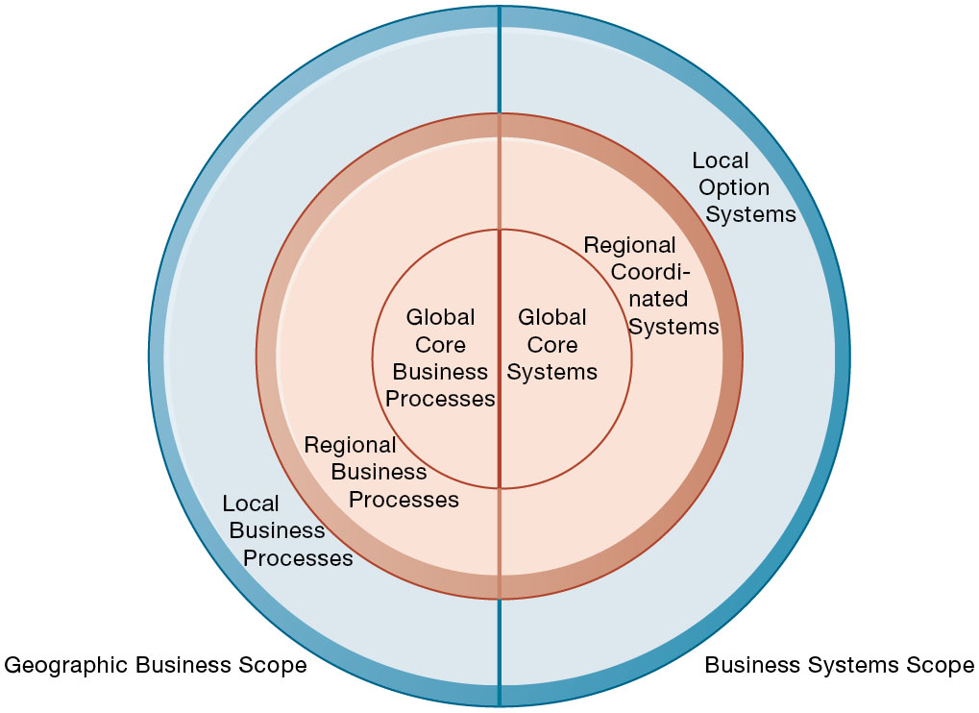
Figure 15.4 Local, Regional, and Global Systems
Notes:
Figure 15.4, Page 572.
Agency and other coordination costs increase as the firm moves from local option systems toward regional and global systems. However, transaction costs of participating in global markets probably decrease as firms develop global systems. A sensible strategy is to reduce agency costs by developing only a few core global systems that are vital for global operations, leaving other systems in the hands of regional and local units.
This graphic illustrates the scope of the three different categories of system (global, regional, local). Give the student an example industry, say, sports apparel manufacturing, and ask students to describe what local, regional, and global business processes might be. Use Nike as an example—a U.S. firm for design, marketing, sales and distribution where all the products are made in offshore factories.
Alt Text
Long description: A concentric circle diagram divided into two halves illustrates local, regional, and global systems. There are three circles in this diagram and the details are as below:
In the inner circle on the left side are global core business processes. In the second circle are regional processes and in the outermost circle are local business processes.
In the inner circle on the right side are global core systems. In the second circle are regional coordinated systems and in the outermost circle are local option systems.

Slide 25
The Management Solution: Implementation (2 of 2)
Coordinating software releases
  Institute procedures to ensure all operating units update at same time
Encouraging local users to support global systems
  Cooptation: Bringing the opposition into design and implementation process without giving up control over direction and nature of the change
    Permit each country unit to develop one transnational application
    Develop new transnational centers of excellence
Notes:
This slide continues the discussion of solutions to the management challenges. What types of difficulties might there be in having all units update software at the same time? Why does the text suggest that, as much as possible, raw power—commanding people—should be avoided, when dealing with user resistance?

Slide 26
Issues and Technical Alternatives When Developing International Information Systems (1 of 2)
Computing platforms and systems integration
  How new core systems will fit in with existing suite of applications developed around globe by different divisions
  Standardization: Data standards, interfaces, software, and so on
Connectivity
  Internet does not guarantee any level of service
  Many firms use private networks and V P N s
  Low penetration of P C s, outdated infrastructures in developing countries
Notes:
This slide and the next emphasize the types of technological, rather than organizational, challenges faced when building a global system. It is important to note that all units having the same hardware and operating software does not guarantee integration, data standardization must also be enforced. For example, technical accounting terms such as the beginning and end of the fiscal year must be standardized.

Slide 27
Issues and Technical Alternatives When Developing International Information Systems (2 of 2)
Software
  Integrating new systems with old
  Human interface design issues, languages
Software localization
  Converting software to operate in second language
Most important software applications:
  T P S and M I S
  S C M, E D I, and enterprise systems
  Collaboration tools, e-mail, videoconferencing
Notes:
This slide continues the discussion of technology challenges in building global systems. Ask students why MIS and TPS are typically the most important applications.

Slide 28
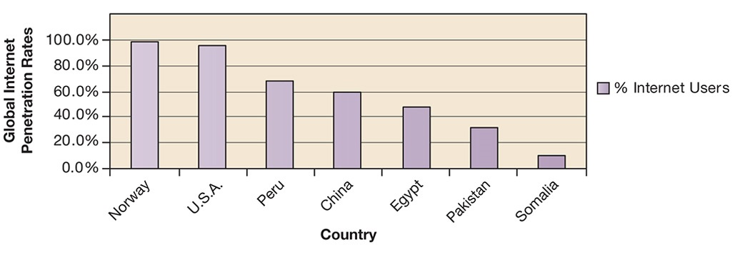
Figure 15.5 Internet Population in Selected Countries
Notes:
Figure 15.5, Page 577.
The percentage of the total population using the Internet in developing countries is much smaller than in the United States and Europe, but it is growing rapidly.
Source: Based on data from Internetworldstats.com, 2019 and authors.
This graph shows the percentage of population using the Internet, by region. It illustrates the lower penetration of Internet usage in developing countries.
Alt Text
Long description: A bar chart presents data on the percentage of Internet users in various countries. The horizontal axis represents various countries as listed below. The vertical axis represents the percentage of internet users and ranges from 0 to 100 % in increments of 20.
Approximate data corresponding to the countries and the percentage of internet users are summarized below:
Norway: 99%
U.S.A.: 95%
Peru: 70%
China: 60%
Egypt: 50%
Pakistan: 30%
Somalia: 10%.

Slide 29
Interactive Session: Organizations: Digital Nationalism
Class discussion
  What is digital nationalism? Give two examples.
  What problems does digital nationalism pose for conducting business globally?

Slide 30
How Will MIS Help My Career?
The Company: Global Online Stats
Position Description: Entry-level sales and marketing trainee
Job Requirements
Interview Questions
Author Tips

Slide 31

Copyright
This work is protected by United States copyright laws and is provided solely for the use of instructors in teaching their courses and assessing student learning. Dissemination or sale of any part of this work (including on the World Wide Web) will destroy the integrity of the work and is not permitted. The work and materials from it should never be made available to students except by instructors using the accompanying text in their classes. All recipients of this work are expected to abide by these restrictions and to honor the intended pedagogical purposes and the needs of other instructors who rely on these materials.

